Slide 1
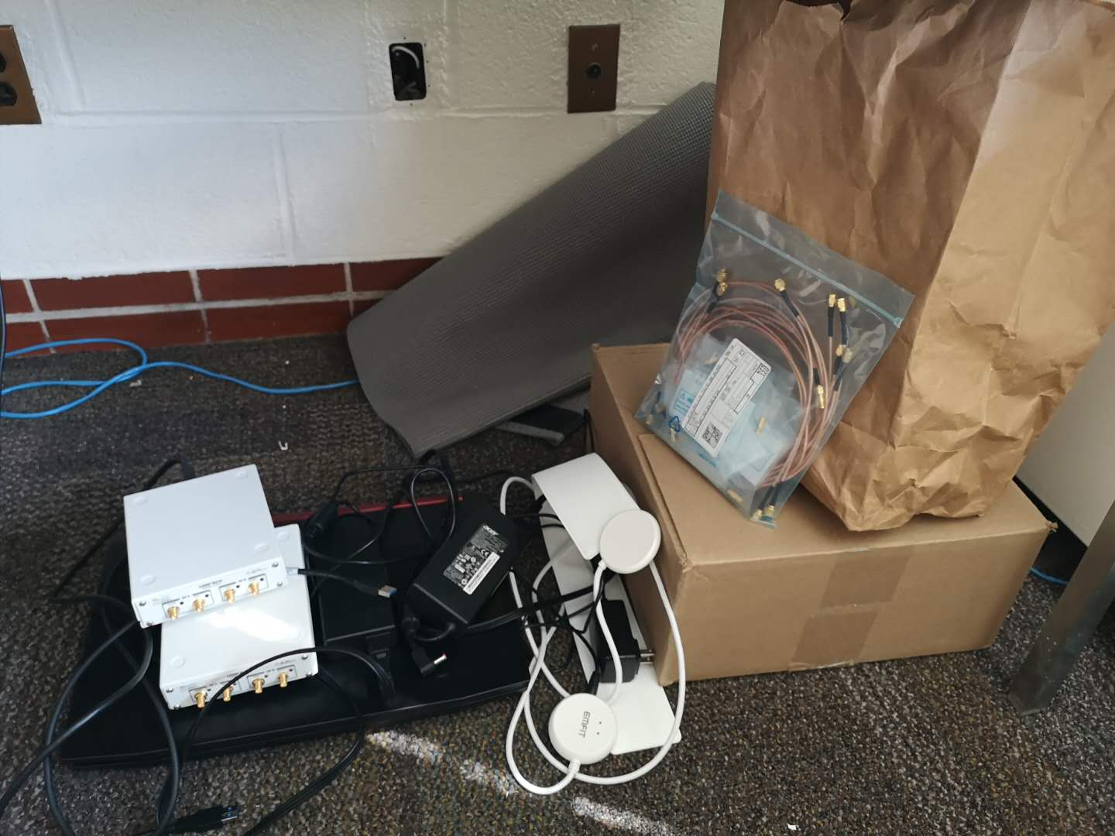
Sleep center setup guide
2 USRP B210
2 laptops
2 fitted sheets with sensors sewing on. One in the box, one in the paper bag.
2 waterproof mattress protectors
Extra cables (6) and female connectors
1 BCG

Slide 2
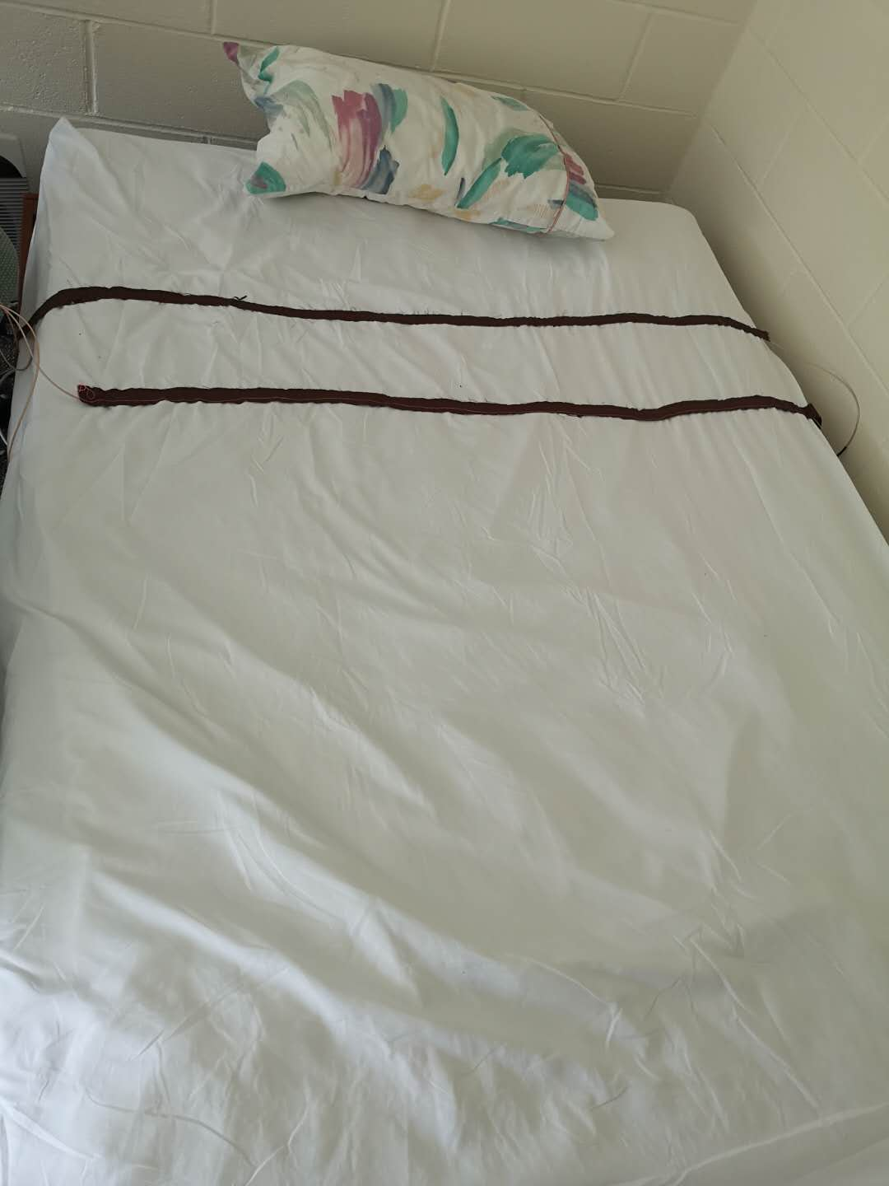
Setup the fitted sheet with two notched sensors (brown sewing strips) one around thorax position, one around abdomen position. Make sure you don’t flip it up side down.

Slide 3
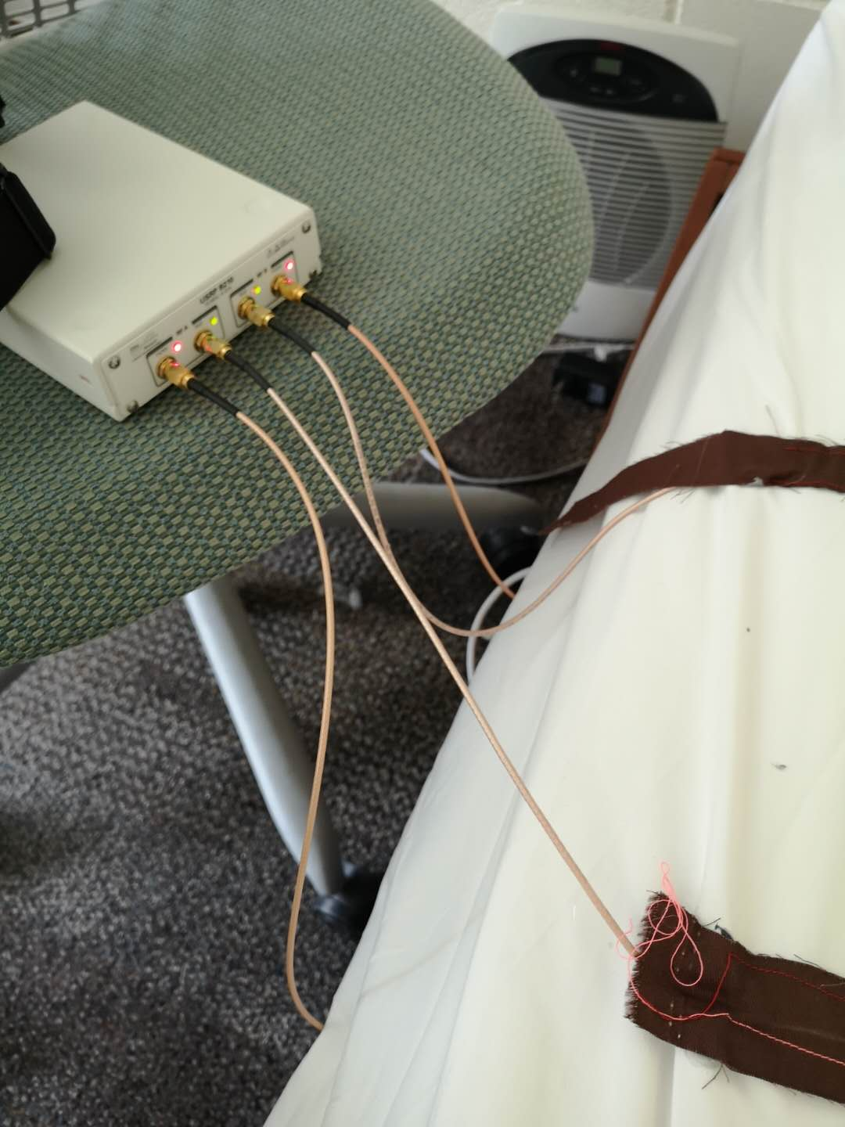
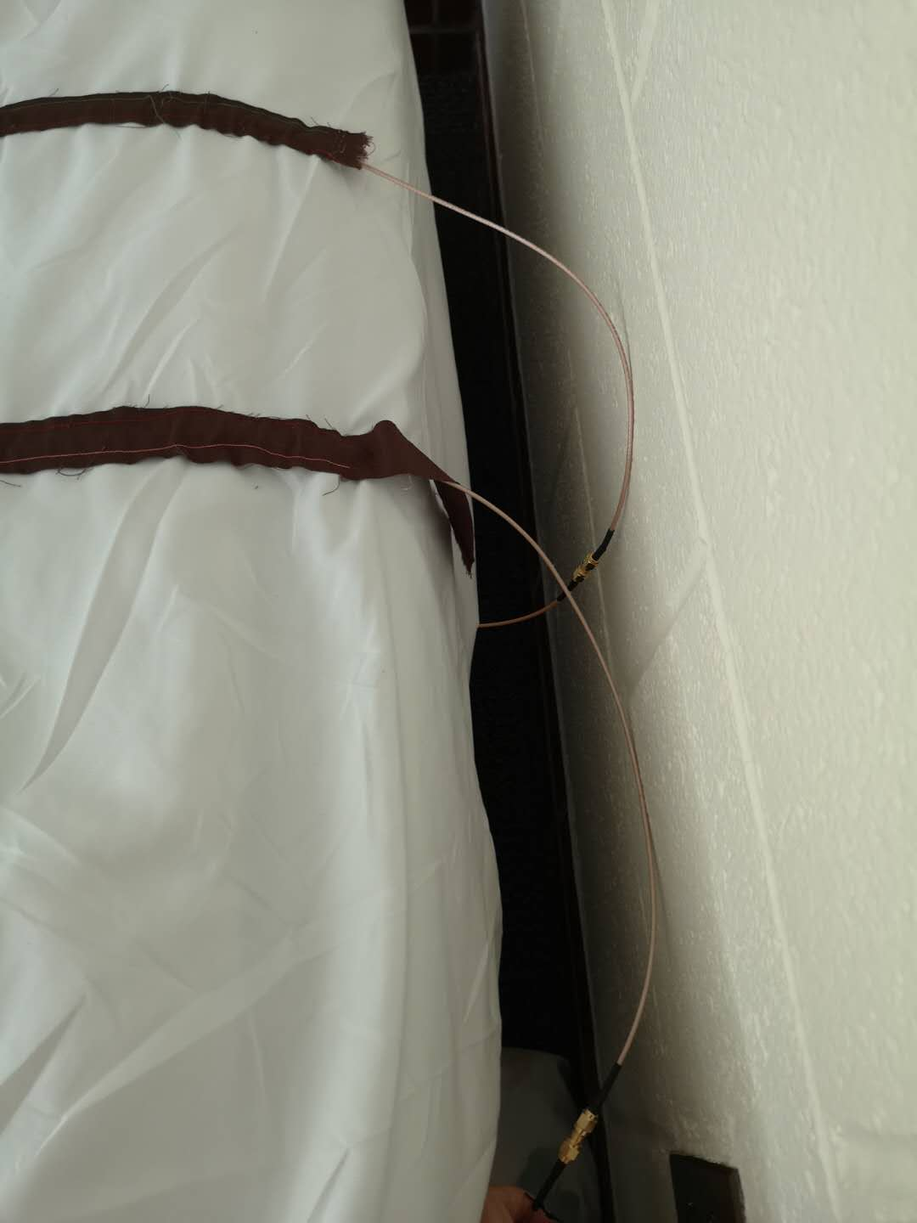
2. Make sure one side connected to the USRP, the other side round back to the mattress.

Slide 4
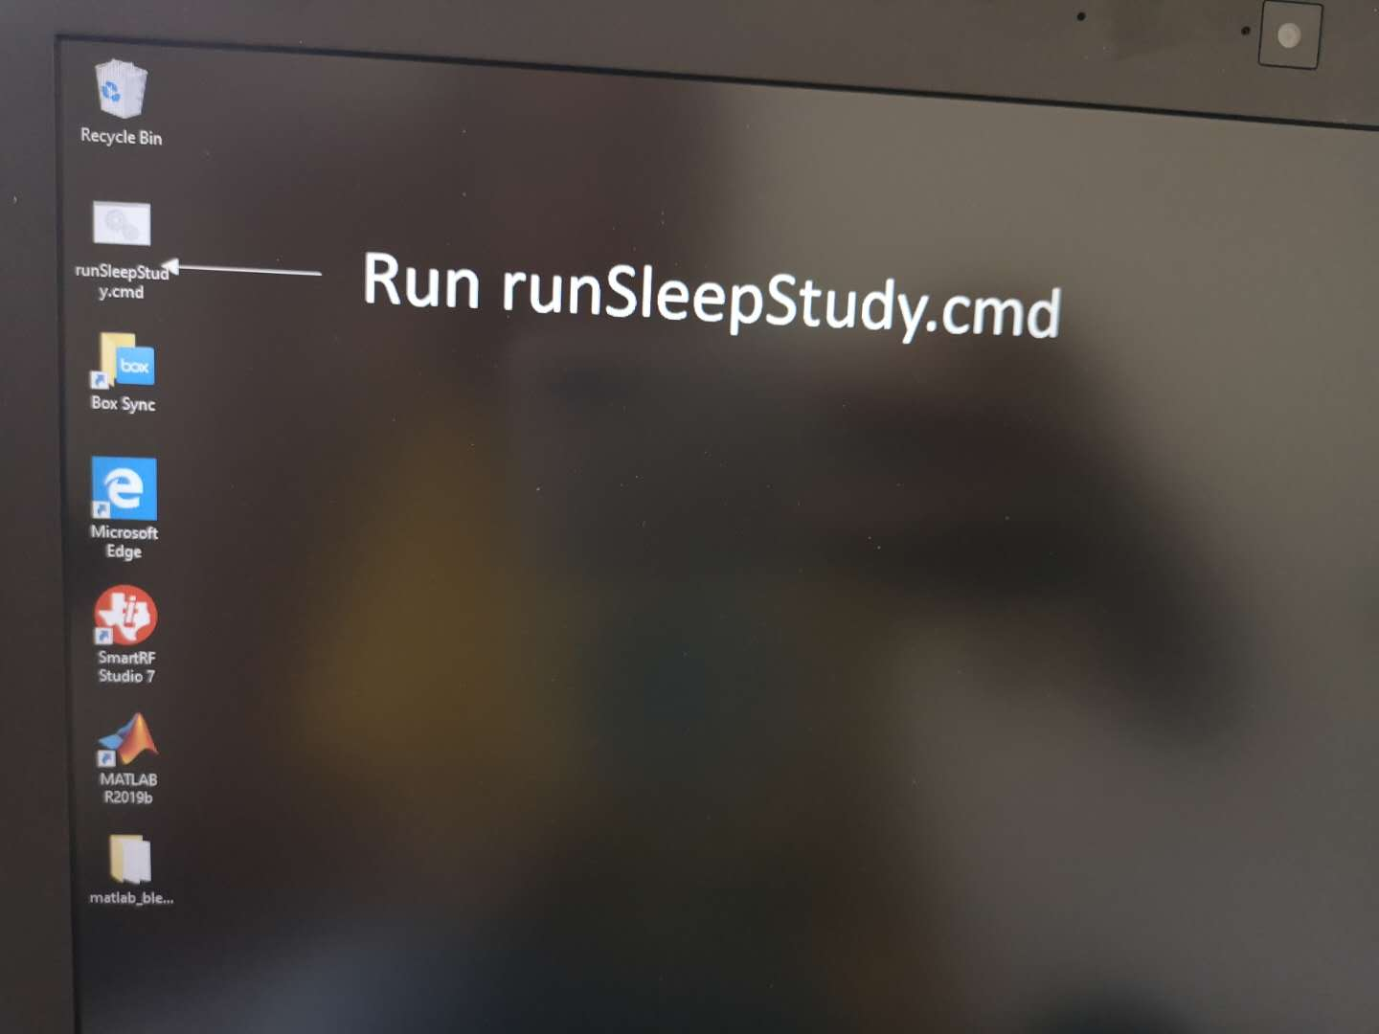
3. Connect the USRP to the computer.
And run the runSleepStudy.cmd
4. Make sure the NCS Amp is not too low or too high. In case the Amp is too low or too high, we can change the gain and rebuild the exe file.
If we need more discussion during the setup, please contact me or call me. Phone: 6072621372

